Slide 1
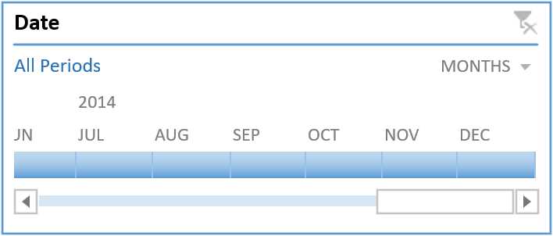
SAMPLE SUPERSTORE DASHBOARD

Slide 2
OVERVIEW
OBJECTIVE.
DATA PREPROCESSIONG
PLOTTING PIVOT CHART
PROFIT BY COUNTRY
SALES & PROFIT BY SEGEMENTS
c. SALES & PROFIT BY CATEGORY
DATE AND STATES FILTER USED BY SLIDER
CONCLUSION
RECOMMENDATIONS

Slide 3
OBJECTIVE
A superstore wants to analyse its sales data to identity trends, optimize product offerings, and improve customer satisfaction.
The dashboard aims to offer insights into sales trends, profit margins, and customer
Behaviour, enabling businesses to make informed decisions and optimize their strategies.
Provides a comprehensive overview of sales data, including total sales, profit and
Customer information.

Slide 4
DATA PREPROCESSING
Data Cleaning: Handling missing values, removing duplicates, and correcting errors.
Data transformation: Converting data types, aggregating data, and creating new fields.
Data Filtering: Removing irrelevant data and applying filters for analysis.

Slide 5
PROFIT BY COUNTRY
ANALYSIS.”This graph shows that sum of profit by Country.while France country gives highest profit.

Slide 6
SALES BY SEGMENTS
Analysis: "This graph shows that sales by Segments .while Government Segment gives more sales to customers.”

Slide 7
PROFIT BY MONTH
Analysis:” this graph shows that the October month is the most profitable, while March month is the least profitable.

Slide 8
SALES BY PRODUCT
Analysis:” this graph shows that Paseo is the most profitable product than other products.”

Slide 9
THAE STATE FILTER SLIDER
State
The state Filter Slider is a interactive tool that allows users to select specific from a list, enabling targeted analysis and insights.
CANADA
FRANCE
GERMANY
MEXIXO
UNITED STATES

Slide 10
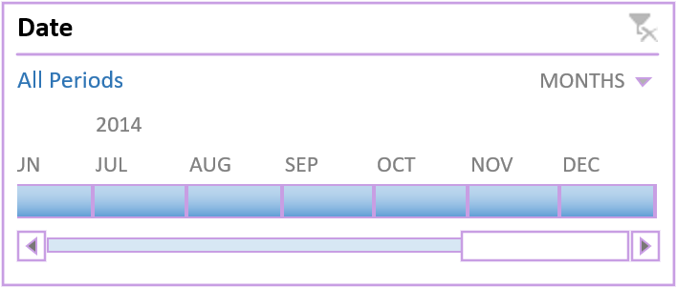
THE ORDER DATE SLIDER
By analysing the data ,we can identify patterns and trends in customer behaviour, such as :-
Seasonal fluctuations- identifying seasonal patterns in sales data
Year-over-year growth- Analysing sales data over time to assess growth and trends
Peak periods- identify peak periods when orders are highest. Used to optimize inventory management, staffing, and marketing strategies.
Low periods:- Identify low periods when orders are scarce. Help us to plan for slow periods, adjust our pricing strategy, or implement targeted marketing campaigns to boost sales.

Slide 11
CONCLUSION
The sample superstore dashboard provides a valuable tool for business to analyse sales data, identify trends, and optimize strategies,
By leveraging data visualization and analytics, business can gain insights into customer behaviour, sales performance, and profit margins, ultimately driving growth and improvement.
The dashboard’s interactive features and drill-down capabilities enable users to explore data in detail, making it an essential resource for data-driven decision making.

Slide 12
RECOMMENDATIONS
Focus on high-selling categories like products.
Revise sales strategies to improve sales and profit.
Invest in the France like country to maximize the profitability.
Build stronger relationships with top customers and products.

Slide 13


